Slide 1
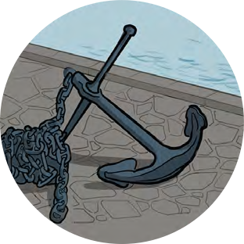
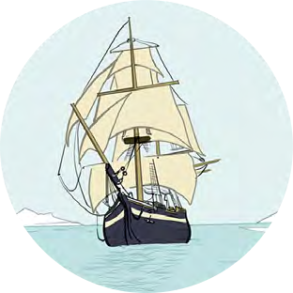
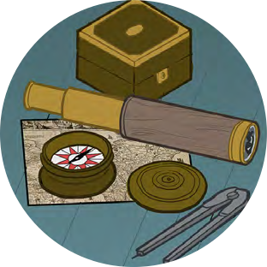
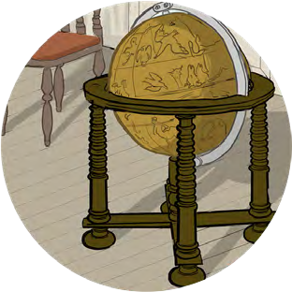
Black Tudors and the sea
Using historical sources to find out about the past
Looking Closer

Slide 2
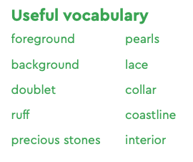
Looking Closer
Look closely at the images and objects on these slides
Working in a group as a whole class, take it in turns to spot a different detail in the image, it could be–
Can everyone in the group spot something different?
a hat
a globe
Or anything else you can see
a necklace
a sailing ship

Slide 3
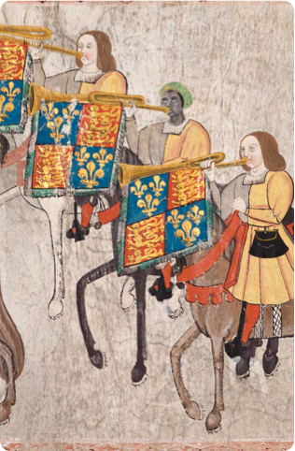
Looking Closer
Challenge!
Turn this into a memory game
Make a group of six.
The first person looks carefully at your image and says “I looked at the (e.g. portrait) and I saw ...” They then give a detail such as a hat, a horse, a trumpet.
The second person does the same, choosing a different detail and adding it to the first: “I looked at the portrait and I saw ... a trumpet and a horse”.
Everyone takes their turns, each choosing a different detail and adding it to the list, in order until the final person who must recite the five previous choices in the right order and then add their own.
Then you can play again with a new image, the person that went last before gets to start this time

Slide 4
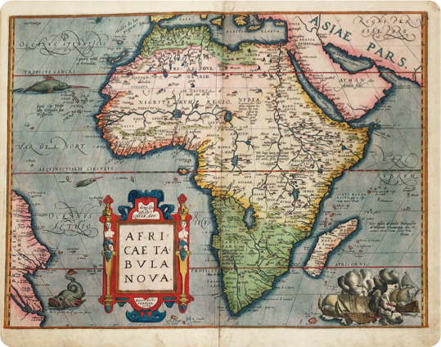
Map of Africa
Africae Tabula Nova
(A new map of Africa) (1570)
Abraham Ortelius
National Maritime Museum, Greenwich, London: PBD7640(4)

Slide 5
John Blanke
Detail from the Westminster Tournament Roll (1511)
College of Arms MS Westminster Tournament Roll.
Reproduced by permission of the Kings, Heralds and Pursuivants of Arms.

Slide 6
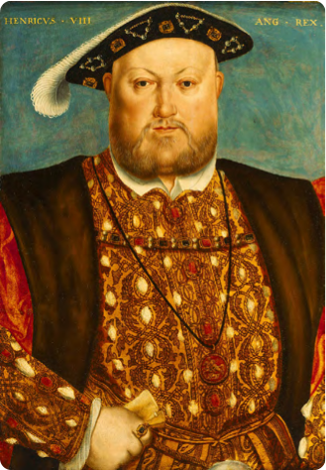
Henry VIII
Henry VIII, 1451–1547
Studio of Hans Holbein (c.1535) National Maritime Museum, Greenwich, London, Caird Collection: BHC2763

Slide 7
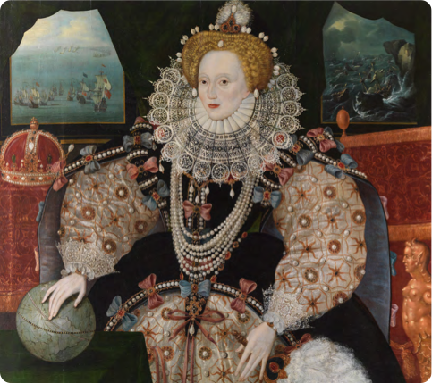
Queen Elizabeth I
Elizabeth I, the Armada Portrait
c.1588 National Maritime Museum, Greenwich, London. Acquired with the support of the Heritage Lottery Fund, Art Fund, Linbury Trust, Garfield Weston Foundation, Headley Trust and other major donors, together with contributions from over 8000 members of the public following a joint appeal with Art Fund.

Slide 8
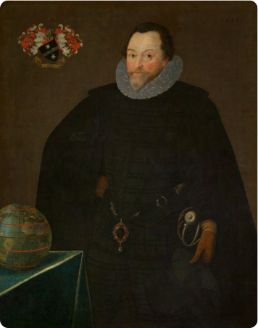
Francis Drake
Sir Francis Drake, 1540–96
by Marcus Gheeraerts, 1591
National Maritime Museum, Greenwich, London, Caird collection: BHC2662

Slide 9
Looking Closer
How many things did you find in the image that you didn’t realise were there at first?
Why is looking closely at objects very important for people trying to learn about the past?

