Slide 1
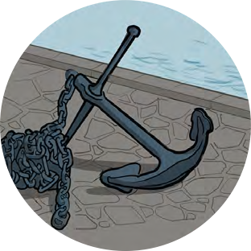
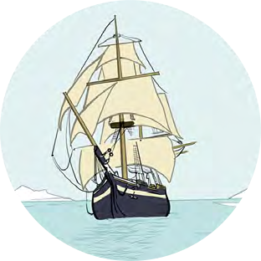
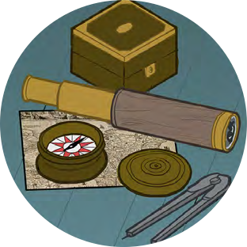
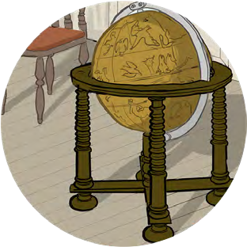
Black Tudors and the sea
Using historical sources to find out about the past
Talking Tudors

Slide 2
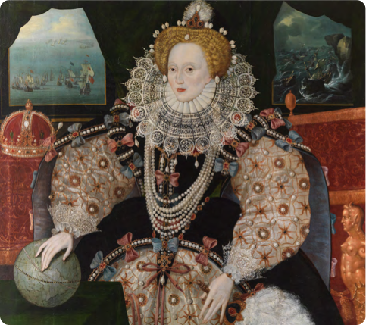
Talking Tudors
Portraits
What might I be thinking?
If I could speak, what do you think I might tell you?

Slide 3
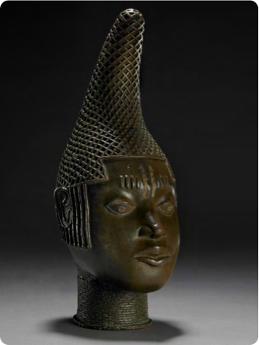
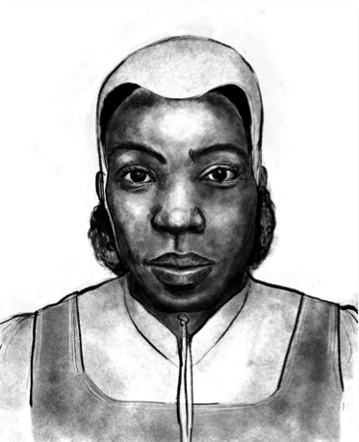
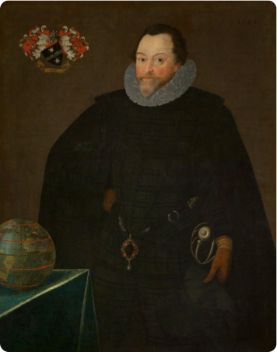
What would we want to tell someone looking at this artwork today?
Talking Tudors
Portraits
What might we be thinking?
What would we say to the artist making the portrait or object?
How might what we would think and what we might say be different?

Slide 4
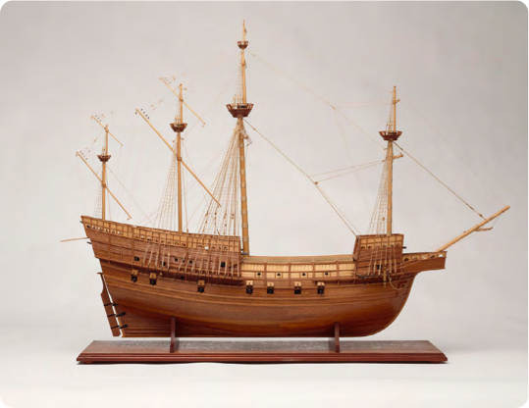
Talking Tudors
Objects
If an object could talk, what would these objects say?
What might it see, hear, smell?
If it had feelings, how might it feel about the job it was made to do or about the person who used it?
What might it get up to when no one’s looking?
What might it wish...?
Queen mother ‘Idia’s’ beaded headdress
Useful Vocabulary:
Personification – giving human characteristics to objects or animals
John Blanke’s trumpet and banner
Model of the Mary Rose
Elizabeth I’s pearls

Slide 5
What might I be thinking?
Commemorative head of Queen Mother ‘Idia’
Edo people c.1500
©The Trustees of the British Museum
If I could speak, what do you think I might tell you?

Slide 6
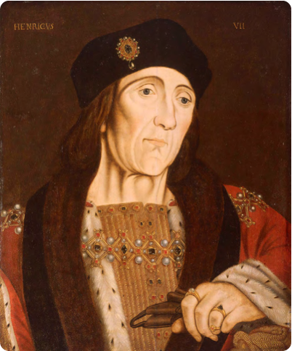
King Henry VII
What might I be thinking?
Studio of Hans Holbein (c.1505) National Maritime Museum, Greenwich, London, Caird collection: BHC2762
If I could speak, what do you think I might tell you?

Slide 7
John Blanke
What might I be thinking?
Detail from the Westminster Tournament Roll (1511)
College of Arms MS Westminster Tournament Roll.
Reproduced by permission of the Kings, Heralds and Pursuivants of Arms.
If I could speak, what do you think I might tell you?

Slide 8
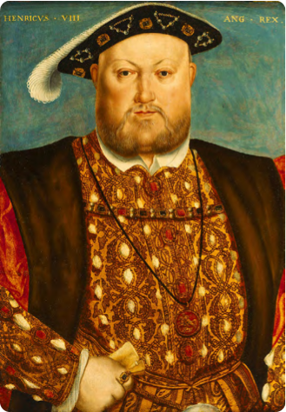
Henry VIII
What might I be thinking?
Henry VIII, 1451–1547
Studio of Hans Holbein (c.1535) National Maritime Museum, Greenwich, London, Caird Collection: BHC2763
If I could speak, what do you think I might tell you?

Slide 9
Queen Elizabeth I
What might I be thinking?
Elizabeth I, the Armada Portrait
c.1588 National Maritime Museum, Greenwich, London. Acquired with the support of the Heritage Lottery Fund, Art Fund, Linbury Trust, Garfield Weston Foundation, Headley Trust and other major donors, together with contributions from over 8000 members of the public following a joint appeal with Art Fund.
If I could speak, what do you think I might tell you?

Slide 10
Francis Drake
What might I be thinking?
Sir Francis Drake, 1540–96
by Marcus Gheeraerts, 1591
National Maritime Museum, Greenwich, London, Caird collection: BHC2662
If I could speak, what do you think I might tell you?

Slide 11
Cattelena of Almondsbury
What might I be thinking?
Illustration by Shaun Campbell, 2021
If I could speak, what do you think I might tell you?

Slide 12
Model of the Mary Rose
Model of the Mary Rose, 1509; a 60 gun warship
National Maritime Museum, Greenwich, London: SLR3012
What might I be thinking?
If I could speak, what do you think I might tell you?

