Slide 1
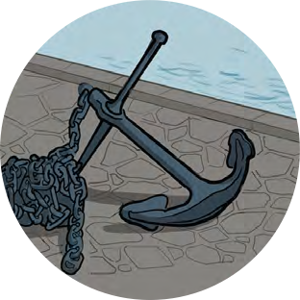
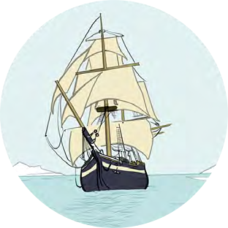
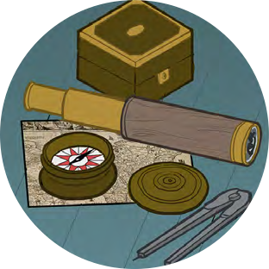
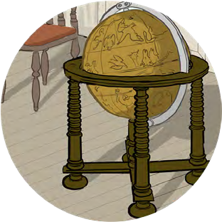
Black Tudors and the sea
Using historical sources to find out about the past
Reliable Evidence

Slide 2
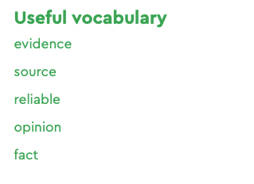
Reliable Evidence
Primary sources are objects, paintings, letters and other items from the past
They can tell us a lot about people and events from the past.
The problem is that they are not always RELIABLE
This means you can’t be sure that an object is a realistic representation of the past
For example a portrait might have been painted to make the sitter look a particular way – younger, richer or more powerful.

Slide 3
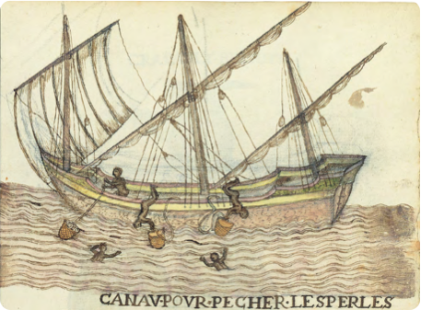
Reliable Evidence
Step one – Investigate the Object
Pick an object to investigate using these questions
I can see… (what can you tell by looking at the object?)
I know… (what knowledge do you already have about what you can see?)
I wonder… (now you have looked at it what questions would you like to ask?)

Slide 4
Reliable Evidence
Step two – Is the object a reliable source of information?
What useful things can this object tell us about the past?
What questions do you still have?
Do you think this is a reliable source of information?

Slide 5
Reliable Evidence
Thinking Further
What sources might people of the future use to find out about our lives today?
Where might you be able to find them?
Do you think they have been saved or collected for us to see? Why/why not?
What other sources would have been useful to find out about the lives of people in the Tudor period?

Slide 6
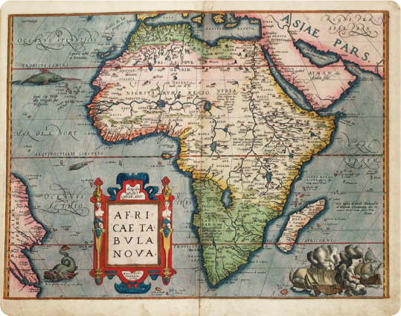
Map of Africa
Africae Tabula Nova
(A new map of Africa) (1570)
Abraham Ortelius
National Maritime Museum, Greenwich, London: PBD7640(4)

Slide 7
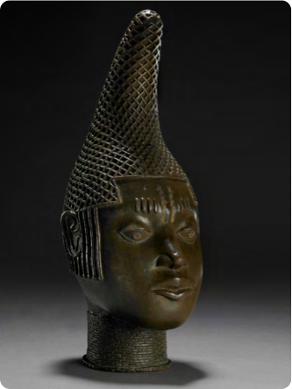
Commemorative head of Queen Mother ‘Idia’
Edo people c.1500
©The Trustees of the British Museum

Slide 8
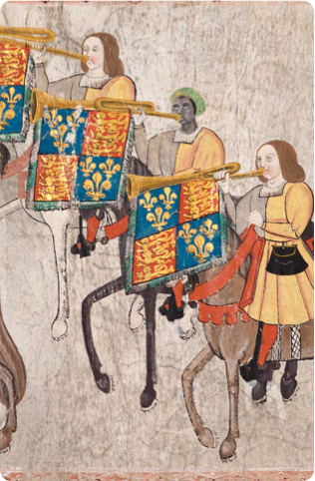
John Blanke
Detail from the Westminster Tournament Roll (1511)
College of Arms MS Westminster Tournament Roll.
Reproduced by permission of the Kings, Heralds and Pursuivants of Arms.

Slide 9
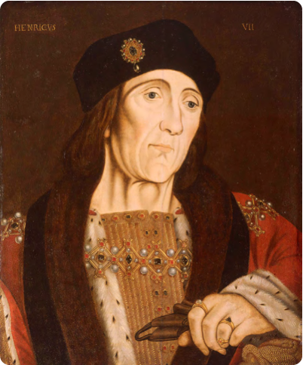
King Henry VII
Portrait of Henry VII
Studio of Hans Holbein (c.1505) National Maritime Museum, Greenwich, London, Caird collection: BHC2762

Slide 10
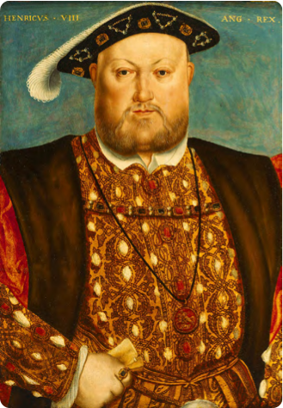
Henry VIII
Henry VIII, 1451–1547
Studio of Hans Holbein (c.1535) National Maritime Museum, Greenwich, London, Caird Collection: BHC2763

Slide 11
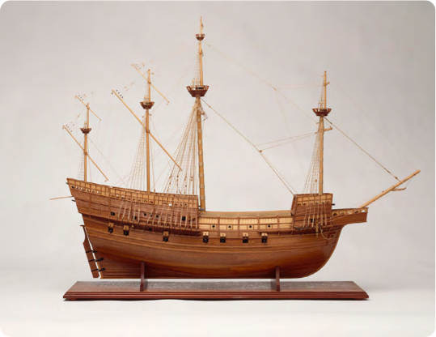
Model of the Mary Rose
Model of the Mary Rose, 1509; a 60 gun warship
National Maritime Museum, Greenwich, London: SLR3012

Slide 12
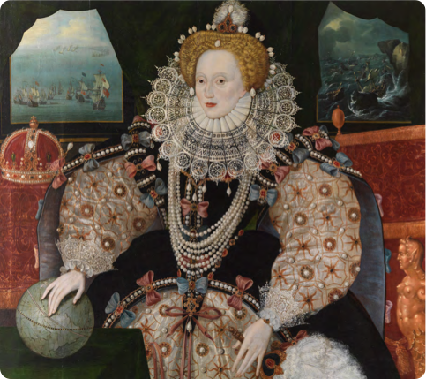
Queen Elizabeth I
Elizabeth I, the Armada Portrait
c.1588 National Maritime Museum, Greenwich, London. Acquired with the support of the Heritage Lottery Fund, Art Fund, Linbury Trust, Garfield Weston Foundation, Headley Trust and other major donors, together with contributions from over 8000 members of the public following a joint appeal with Art Fund.

Slide 13
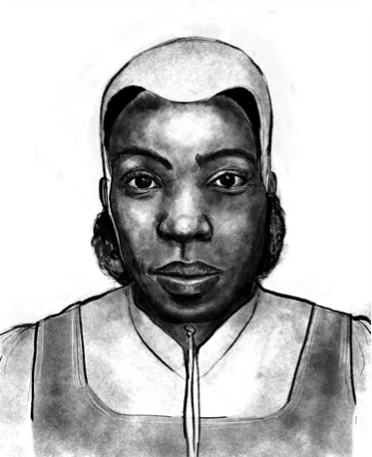
Cattelena of Almondsbury
Illustration by Shaun Campbell, 2021

Slide 14
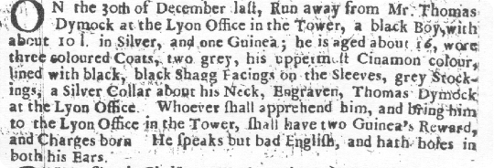
Edward Francis
Runaway from the Tower notice
London Gazette 5-7 January, 1687
TRANSCRIPT - On the 30th December last, run away from Mr Thomas Dymock at the Lion Office in the Tower, a Black boy with about 10 lbs [weight] in silver and one Guinea. He is aged about 16, wore three coloured coats, the uppermost cinnamon colour lined with black, black shag facings on the sleeves, grey stockings, a silver collar about his neck engraved Thomas Dymock at the Lion Office. Whoever shall apprehend him and bring him to the Lion Office in the Tower shall have two guineas reward and charges born. He speaks but bad English and has holes in both his ears.

