Slide 1
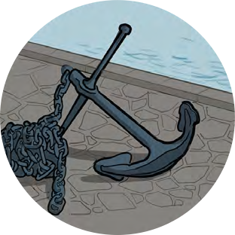
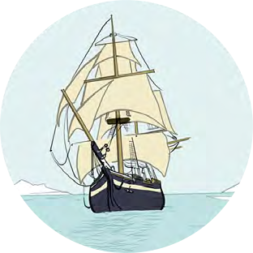
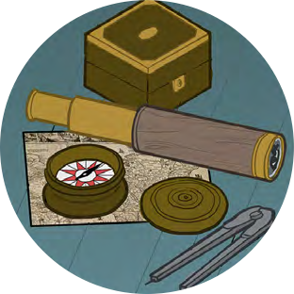
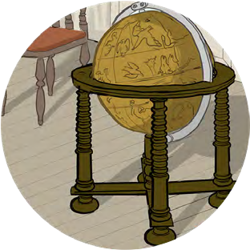
Black Tudors and the sea
Making Connections
Tudor England

Slide 2
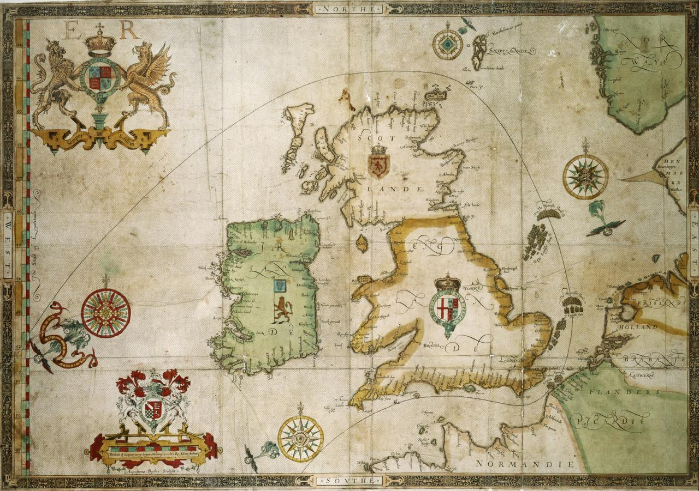
Tudor England
Challenge – Can you find a modern map of England?
Can you Find:
Portsmouth – where Henry VII built the first royal dockyard
Greenwich – where Henry VIII and Elizabeth I were born
Plymouth – where Diego and Drake set sail on the circumnavigation voyage in 1577
Bristol – where 135 African people arrived on board the Charles in 1590 and possibly where Catellena arrived in England
Dover – where John Anthony worked.
Why are all these places in the South of England?
Why do you think they are all close to the sea or a big river?

